Slide 1
Testing
CPSC 2150
Kevin Plis

Slide 2
Concepts
Failure – any deviation of the observed behavior from the specified behavior
Erroneous State – the system is in a state such that further processing of the system will result in a failure.
Fault – the mechanical or algorithmic cause of the erroneous state. AKA defect, bug
Fault leads to erroneous state which leads to failure
Test component – part of the system that can be isolated for testing

Slide 3
Testing
Testing is the systematic attempt to find faults/bugs in a planned way in the implemented software
Not the process of demonstrating that faults aren’t present
A successful tests shows us a failure
There is no way to demonstrate that faults are not present through testing unless we can test every possible input
Similar to falsification of scientific theories
Design experiments where the goal is to falsify the theory
If the theory is not falsified, you now have more confidence in the theory
Our goal in testing is to find the errors so we can correct them
If we are unable to find any, we are more confident in our software
Notes:
A failure tells us that a bug exists, but does not tell us the location

Slide 4
Central Limitation of Testing
“Program testing can be used to show the presence of bugs, but never to show their absence!”
— Edsger W. Dijkstra (1972)
So we will discuss formal reasoning also, later.

Slide 5
Test Case
A Test Case contains:
A set of inputs
Includes the state of the object!
Expected results for those input
We use them to detect the existence of faults by causing failures
A failure is a deviation from the expected behavior, so we need to know the expected results
Notes:
When we get a failure we know that a fault exists, we still need to figure out where it is

Slide 6
Unit Testing: Dealing with Scale
Best practice is to test individual units or components of software (one class, one method at a time)
This is known as unit testing
Testing what happens when multiple components are put together into a larger system is known as integration testing
Testing a whole end-user system is known as system testing

Slide 7
Unit Tests
Just focus on one small part of the system at a time
Reduces complexity of the tests
Focuses the test
Easier to pinpoint faults
Independence of testing components
Unit Test Techniques
Equivalence testing
Boundary testing
Path Testing – we will discuss

Slide 8
Test Stub and Test Driver
Test Stub
Partial implementation of components on which the tested components depend
Replaces lower level of code
Test Driver
Partial implementation of component that depends on the test component
Simulates the part of the system that uses the test component
Call’s the test component and then checks the input
Replaces the user interface and higher levels of code
Can be used to isolate possible locations of the fault
Notes:
Can avoid test stubs by testing lower levels of the system first, commonly done

Slide 9
Designing a Test Plan
A Test Plan is the set of test cases for a specific unit.
To make testing most likely to succeed in revealing defects, best practices include:
Test boundary cases: “smallest”, “largest”, “special” values based on the contract
Test routine cases
Test challenging cases, i.e., ones that, if you were writing the code (maybe you didn’t write the code being tested!), you might find difficult or error-prone
We want distinct test cases
Is there a scenario where you would expect one test case to pass and one to fail?
Our Test cases should follow design by contract
We don’t use inputs that go against the preconditions.
Our post conditions help us identify our expected output
Also don’t give test cases that compilers would prevent
Notes:
Compilers prevent unmatching data types, etc. Still test when testing UI

Slide 10
Example Method Contract
/**
* Returns some factor of a number.
* ...
* @precondition
* n > 0
* @postcondition
* aFactor > 0 and
* n mod aFactor = 0
*/
private static int aFactor(int n) {...}

Slide 11
Example Method Contract
This means:
“n is divisible by aFactor”.
/**
* Reports some factor of a number.
* ...
* @precondition
* n > 0
* @postcondition
* aFactor > 0 and
* n mod aFactor = 0
*/
private static int aFactor(int n) {...}

Slide 12
Partial Test Plan
Inputs | Results | Reason
n = 1 | aFactor = 1 | boundary
n = 2 | aFactor = 1 aFactor = 2 | routine challenging? (prime)
n = 4 | aFactor = 1 aFactor = 2 aFactor = 4 | challenging? (square)
n = 12 | aFactor = 1 aFactor = 2 aFactor = 3 aFactor = 4 aFactor = 6 aFactor = 12 | routine

Slide 13
Psychology of Testing
Design and coding are creative activities
Testing is a destructive activity
The primary goal is to “break” the software, i.e., to show that it has defects
Very often the same person does both coding and testing (not a best practice)
You need a “split personality”: when you start testing, become paranoid and malicious
It’s surprisingly hard to do: people don’t like finding out that they made mistakes
Notes:
Better to have separate teams do this, becomes a source of competition

Slide 14
Blackbox vs Whitebox testing
Blackbox
Focus on the input and output behavior
Ignore internal details or structure of the component
Use the contracts to create our test plans
Whitebox
Focuses on internal structure of the component.
Every state of the object and interactions are also tested
Every possible path in the code can be tested
100% code coverage
Look at the code while developing test cases

Slide 15
Blackbox Testing
If we are doing blackbox testing, we don’t use implementation details
We just rely on the interface to test our code
Pros
One test plan can work for any implementation of the same interface
If implementation changes, or a new implementation is developed, we don’t have to change our test plan
Cons
We can’t guarantee 100% code coverage
We don’t look at the code, so we don’t not if we are hitting every path
Techniques for developing good test cases are more conceptually difficult

Slide 16
Whitebox testing
We look at the implementation details
Pros
We can guarantee 100% code coverage
Conceptually easier to develop
Cons
We can miss errors of omission
Can’t develop before the code is written
When the code changes, we may need to change our test plan
New implementations of the same interface require new test plans
Notes:
Errors of omission - if the developer leaves out a step in the logic, so will our test cases

Slide 17
Tracing and Debugging
Objective
Locate errors using test inputs
Approach
Analyze the code on sample test inputs to understand why code fails to behave as specified in its contract
Tracing and Debugging
Tracing: Analyze, but do not execute code
Debugging: Execute code on selected inputs and follow the execution
Notes:
Seriously guys use intelliJs debugger

Slide 18
Test Driven Development (TDD)
A common practice in Software Engineering
Create the automated test cases before writing the code based on the contracts
Then write the code needed to pass your test cases
Pros
You are ready to test your code immediately after writing it
Reducing the time between writing the code and discovering the existence of a fault makes it easier to locate the fault
Developing test cases first forces you to consider challenging inputs and how to handle them
Cons
Only works with blackbox testing
Coding to the test plan relies on having a great test plan

Slide 19
Why does testing matter?
Engineering comes with responsibility
You’re responsible for the product you produce
In Software Engineering, you’re responsible for the software you produce
You want it to be high quality software
Bad software can lead to
Angry customers
Lost money and time
Even loss of life
Let’s consider some historical examples

Slide 20
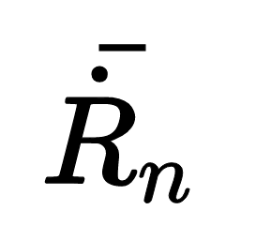
Software Engineering Mistakes
Mariner 1
Supposed to do a flyby of Venus
Cost 18.5 million in 1962 ($146,476,299 today)
NASA lost control of the craft, and had to destroy it 294.5 seconds after launch.
Apparent Cause? Incorrectly transcribed a hand written equation into the code.

Slide 21
Software Engineering Mistakes
Lt. Col. Stanislav Petrov 1982
Soviet Officer monitoring the missile detection system
Alarms went off indicating incoming missiles from America
NATO involved in provocative exercises
Russians had recently shot down a South Korean airliner that went into its air space
Petrov thought it was odd there were only 5 missiles, and told his superiors it was a false alarm, instead of telling them to fire the retaliatory missiles
False alarm caused by the reflection of sunlight off the top of the clouds

Slide 22
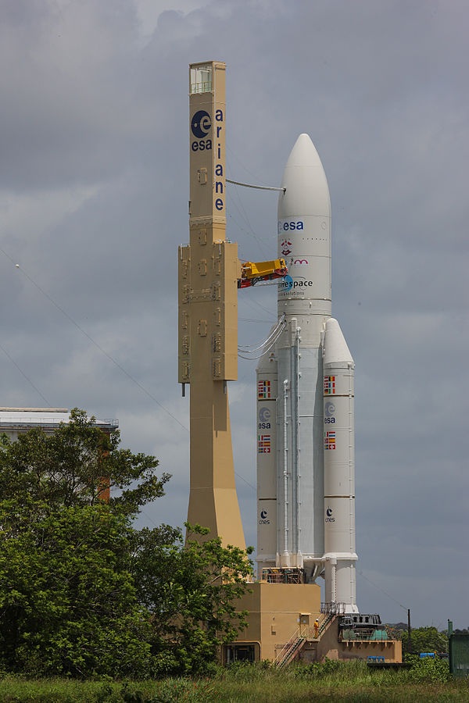
Software Engineering Mistakes
Ariane 5 rocket
First test launch ended in automatically triggered self destruct
Velocity was computed as a 64-bit float
Tried to store velocity in a 16-bit memory register
The number was too large for the register, creating an overload error.
Overload error caused a drastic and unnecessary flight correction
Flight correction caused damage to booster rockets
Damage to the booster rockets resulted in self destruct sequence being activated.

Slide 23
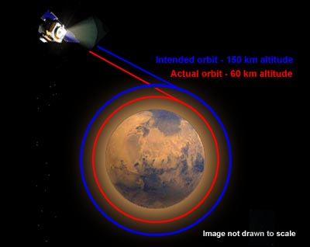
Software Engineering Mistakes
Mars Climate Orbiter
Two teams worked on the software for the orbiter
Lockheed Martin’s team used English Units
NASA’s JPL team used Metric units
When the orbiter tried to calculate the thrust to enter the orbit of Mars the unit difference caused a miscalculation
The orbiter crashed into Mars
The orbiter cost $125 million dollars

